Slide 1
AI Intro Basics #4
MLOps – Machine Learning Operations
Roland Potthast, Marek Jacob, Daniele Nerini

Slide 2
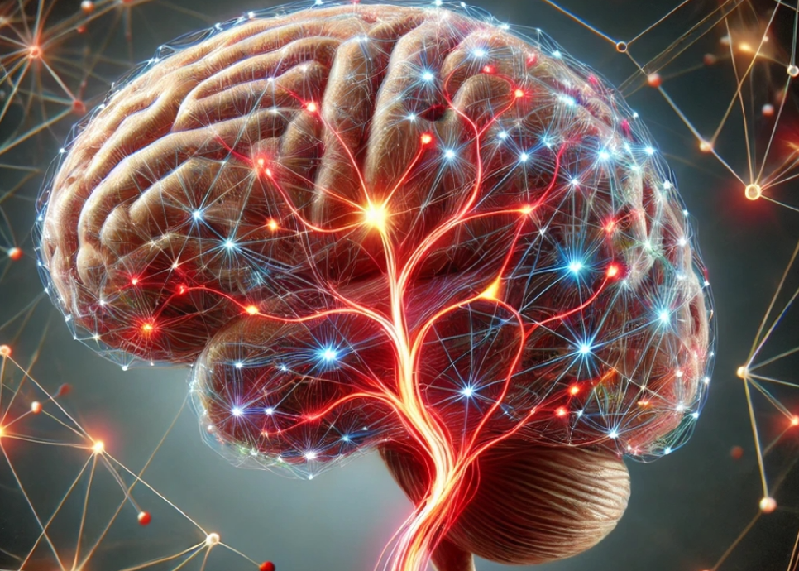
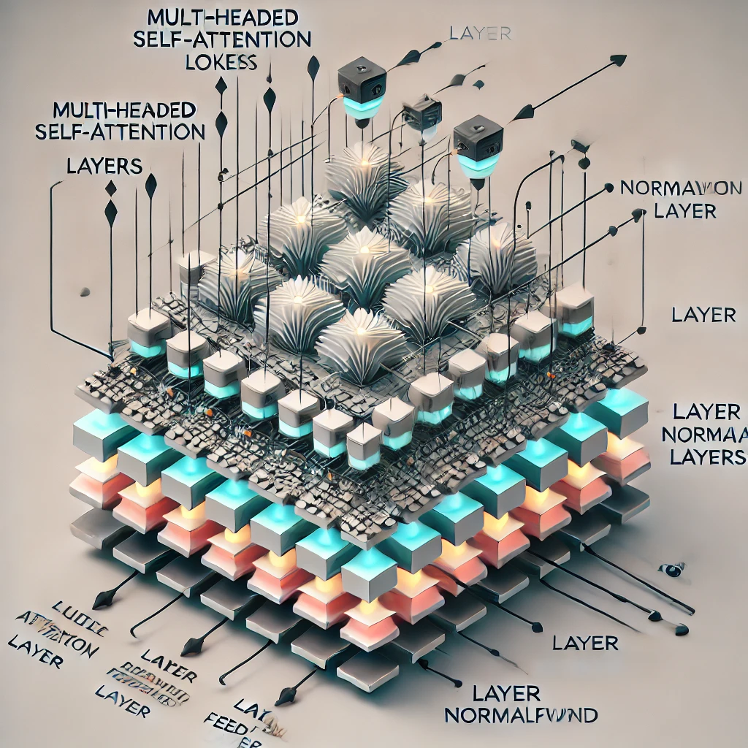
E-AI Basic Tutorials
Tutorial E-AI Basics 4: January Wednesday 22, 2025, 11-12 CET
"MLOps" - Machine Learning Operations
4.1 Overview (20') [RP]
4.2 MLOps in relation to traditional Weather forecasting (20') [MJ]
4.3 Road to MLOps (20’) [DN]
Tutorial E-AI Basics 5: February Wednesday 19, 2025, 11-12 CET
MLflow - an open-source platform for managing the machine learning lifecycle
5.1 Overview - User perspective (20') [TG]
5.2 Logging to MLflow as a ML software developer (20') [HT]
5.3 Running MLflow server as a user and as a service (20') [MJ]
Tutorial E-AI Basics 6: February Wednesday 26, 2025, 11-12 CET
CI/CD - Continuous Integration and Continuous Deployment of ML codes
6.1 Overview – What can CI/CD do for you? (20') [MJ]
6.2 Basic tests with Pytest (20') [JD]
6.3 Setting up a runner (20') [FP]
4.1
AI generated Images, © Roland Potthast 2024

Slide 3
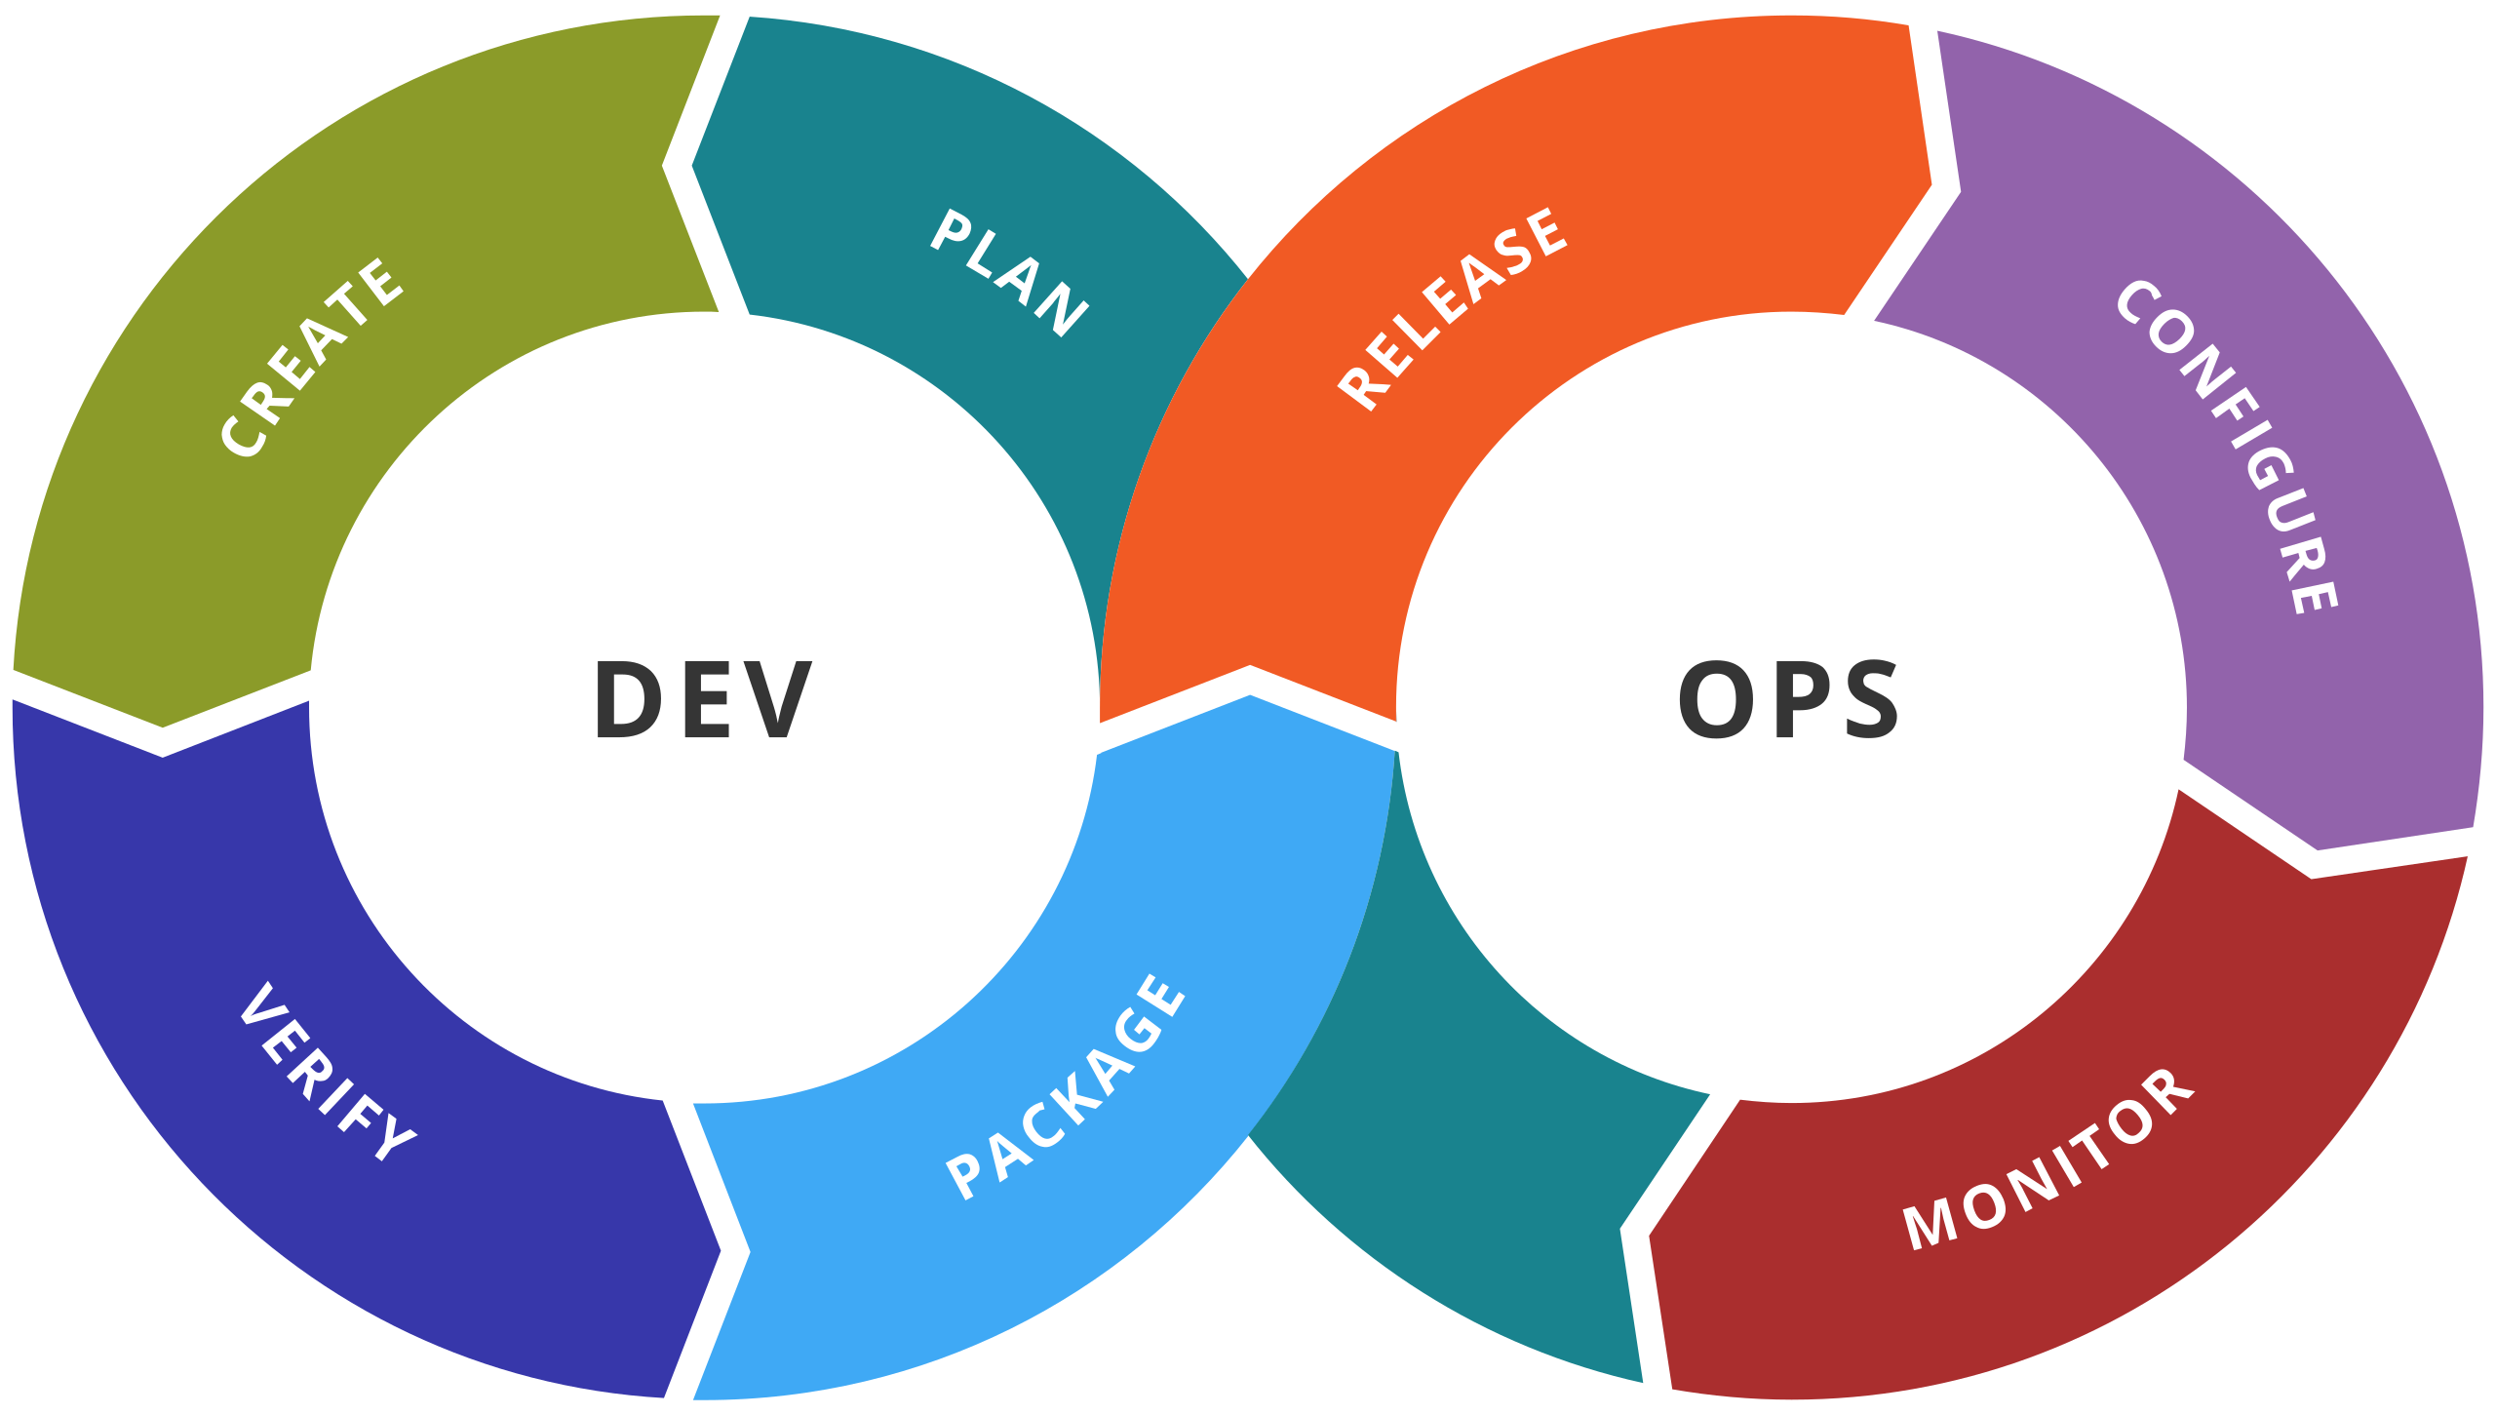
DevOps in Weather and Climate Applications and Services
What is DevOps?
DevOps is an approach that fosters collaboration between development (Dev) and operations (Ops) within an organization. The goal is to reduce the time from development to operation by enhancing communication, automation, and quality assurance.
DevOps in Weather and Climate Applications and Services
In the context of weather and climate applications and services, DevOps enables close collaboration between ML model developers and service operators. This ensures that models and systems are:
Accurately implemented for operational use.
Supported by automated processes, such as:
Data integration
Model training
Validation
Deployment

Slide 4

ML Ops in Weather and Climate Applications and Services
What is ML Ops?
ML Ops is a specialized approach focused on managing machine learning models—from training and validation to deployment and monitoring. The goal is to improve model quality, reliability, and scalability throughout its lifecycle.
ML Ops in Weather and Climate Applications and Services
Operators ensure that ML models are:
Correctly trained and validated.
Monitored for performance, with error identification and corrective actions.
Scalable and robust to handle operational demands.
Key Practices
Model Versioning: Managing different versions and tracking performance.
Automated Testing: Ensuring model quality through continuous testing.
Continuous Integration & Deployment: Seamless updates to models.
Data Security: Safeguarding data used for training and operation.

Slide 5
From Research to Operations – Building Blocks I
1. Version Control and Source Code Management
Use Case: Manages code changes and enables team collaboration (e.g., Git).
Considerations: Branching strategies (e.g., GitFlow), conflict resolution, versioning infrastructure code.
2. CI/CD (Continuous Integration/Continuous Deployment)
Use Case: Automates the build, test, and deployment processes.
Considerations: Test coverage, automation tools (e.g., Jenkins, GitHub Actions), deployment strategies (e.g., Blue-Green Deployments).
3. Infrastructure as Code (IaC)
Use Case: Defines and manages infrastructure programmatically (e.g., Terraform, Ansible).
Considerations: Repeatability, modularity, handling sensitive credentials securely.
4. Monitoring and Logging
Use Case: Monitors systems and applications (e.g., Prometheus, Grafana, ELK Stack).
Considerations: Define KPIs, avoid logging sensitive data, and set up alerts for critical issues.
5. Automation
Use Case: Reduces manual tasks (e.g., testing, deployments, updates).
Considerations: Write effective scripts, integrate workflows, and choose suitable automation tools.

Slide 6
From Research to Operations – Building Blocks II
6. Collaboration and Communication
Use Case: Improves transparency and teamwork between development and operations.
Considerations: Use tools like Slack or Rocket Chat, establish feedback loops, and define clear responsibilities.
7. Security (DevSecOps)
Use Case: Integrates security into development from the start.
Considerations: Automate security checks, manage vulnerabilities, and enforce access controls.
8. Containerization and Orchestration
Use Case: Standardizes applications and deployment processes (e.g., Docker, Kubernetes).
Considerations: Resource allocation, scalability, and managing network communication.
9. Feedback and Continuous Improvement
Use Case: Drives improvement through feedback loops and analytics.
Considerations: Gather data, hold retrospectives, and define metrics to measure success.
10. Scalability, Reliability and Portability
Use Case: Ensures systems are flexible and robust.
Considerations: Redundancy, load testing, and implementing auto-scaling strategies.

Slide 7
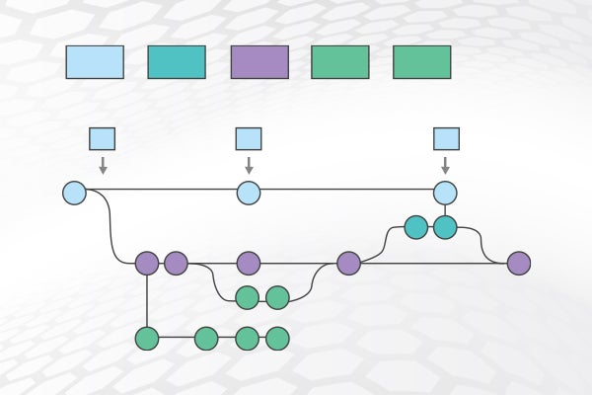
Versioning of Code - Example Git Playground 1
Install git bash on your computer (e.g. windows), open a bash
Let us generate a bare git repository
mkdir git_demo_store
cd git_demo_store/
git init --bare
Clone your repo to get a working repo
git clone git_demo_store git_demo_work
Cloning into 'git_demo_work'...
warning: You appear to have cloned an empty repository.
done.
USE Git repositories to make sure
Code is always saved on another computer
All changes are monitored all the time

Slide 8
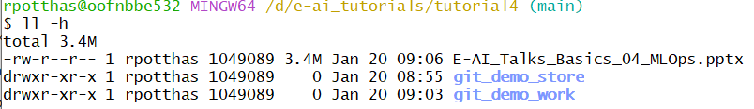
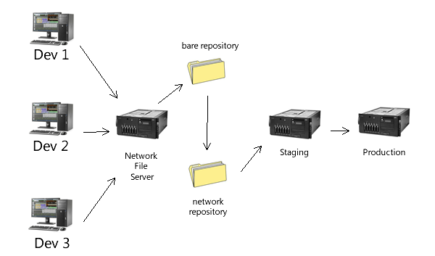
Example Git Playground 2: bare repo and cloned repo
We now have a bare repo (which is a full repo) and a cloned repo for work. This can also be done via ssh, and you can use the base repo as your reference and work with various work repos on other computers.
Add a demo file, commit and push
echo "Hello, World!" > demo.txt
git add demo.txt
git commit -m "Initial commit"
git push
Play around with git add, checkout, push and also explore how to restore previous versions, how to monitor commits etc …

Slide 9
CI-CD trigger: Example Git Playground 3: post-receive
In hooks/ directory of the base repo
git_demo_store
generate a file
post-receive
with the content on the right.
#!/bin/bash
# Simple post-receive hook demo
WORK_TREE="/d/e-ai_tutorials/tutorial4/git_demo_work"
GIT_DIR="$(pwd)" # Automatically set to the path of the base repository
echo "Post-receive hook triggered. Updating work tree..."
git --work-tree="$WORK_TREE" --git-dir="$GIT_DIR" checkout -f
echo "Work tree updated successfully."
Updates the git_demo_work repo when pushing from git_demo_work2
You might need to set file rights to executable:
chmod +x /d/e-ai_tutorials/tutorial4/git_demo_store/hooks/post-receive

Slide 10
Example Git Playground 4: post-receive trigger
Now clone the repo another time into git_demo_work2
Change the demo.txt in the second git clone, add, commit and push.
You get an output such as:
rpotthas@oofnbbe532 MINGW64 /d/e-ai_tutorials/tutorial4/git_demo_work2 (master)
$ git push
Enumerating objects: 5, done.
Counting objects: 100% (5/5), done.
Writing objects: 100% (3/3), 297 bytes | 297.00 KiB/s, done.
Total 3 (delta 0), reused 0 (delta 0), pack-reused 0 (from 0)
remote: Post-receive hook triggered. Updating work tree...
remote: Work tree updated successfully.
To D:/e-ai_tutorials/tutorial4/git_demo_store
c9be361..2b2fd50 master -> master
Updates the git_demo_work repo when pushing from git_demo_work2

Slide 11
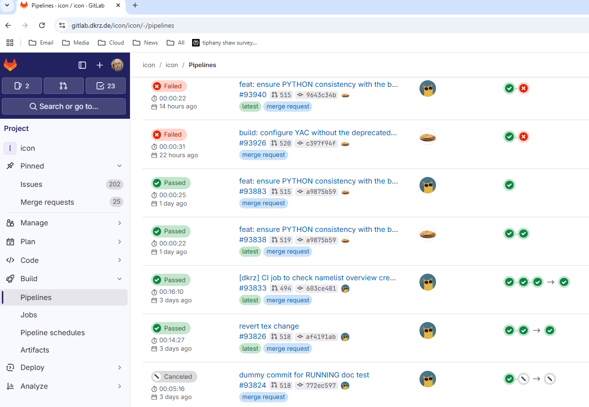
Gitlab CI-CD Pipeline
Integrate continuous integration pipeline into git repository

Slide 12
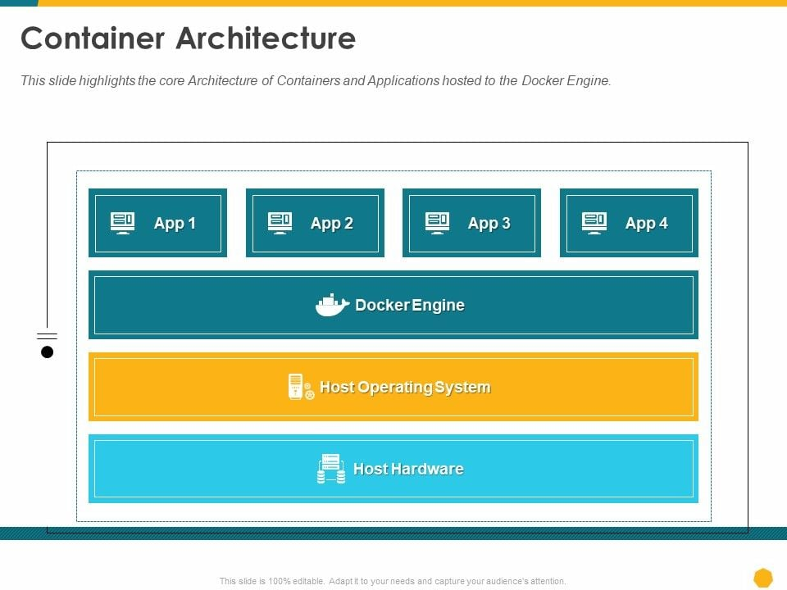
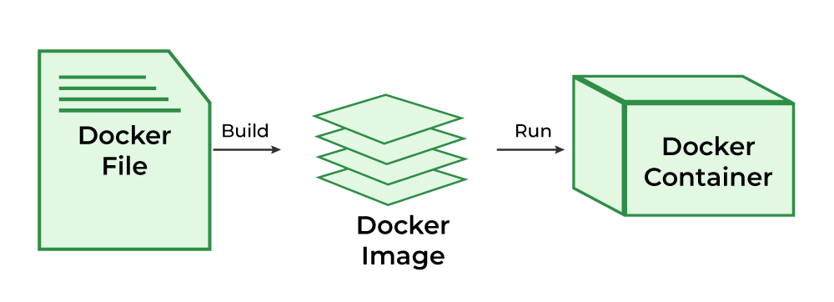
Infrastructure as Code (IaC) / Container Example: Dockerfile
Create a controllable Environment for your Application

Slide 13
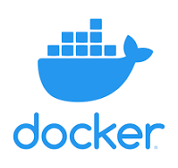
Infrastructure as Code (IaC) / Container Example: Dockerfile
Make sure docker is installed on your machine.
Docker Container are build based on descriptive code, the Dockerfile
# Use Ubuntu as the base image
FROM ubuntu:20.04
# Ubuntu already includes Bash, but we'll ensure updates
RUN apt-get update && apt-get install -y bash && apt-get clean
# Set the default command to start Bash
CMD ["bash"]
Dockerfile
Build Container
docker build -t my-ubuntu-bash-container .
docker run -it my-ubuntu-bash-container
Run Container

Slide 14
Docker File for Machine Learning Applications
# Use an official PyTorch base image
FROM pytorch/pytorch:2.0.1-cuda11.8-cudnn8-runtime
# Install Jupyter and other dependencies
RUN apt-get update && apt-get install -y python3-pip && \
pip install --no-cache-dir notebook && \
apt-get clean
# Expose the port for Jupyter Notebook
EXPOSE 8888
# Set the default command to start Jupyter Notebook
CMD ["jupyter", "notebook", "--ip=0.0.0.0", "--port=8888", "--no-browser", "--allow-root"]

Slide 15
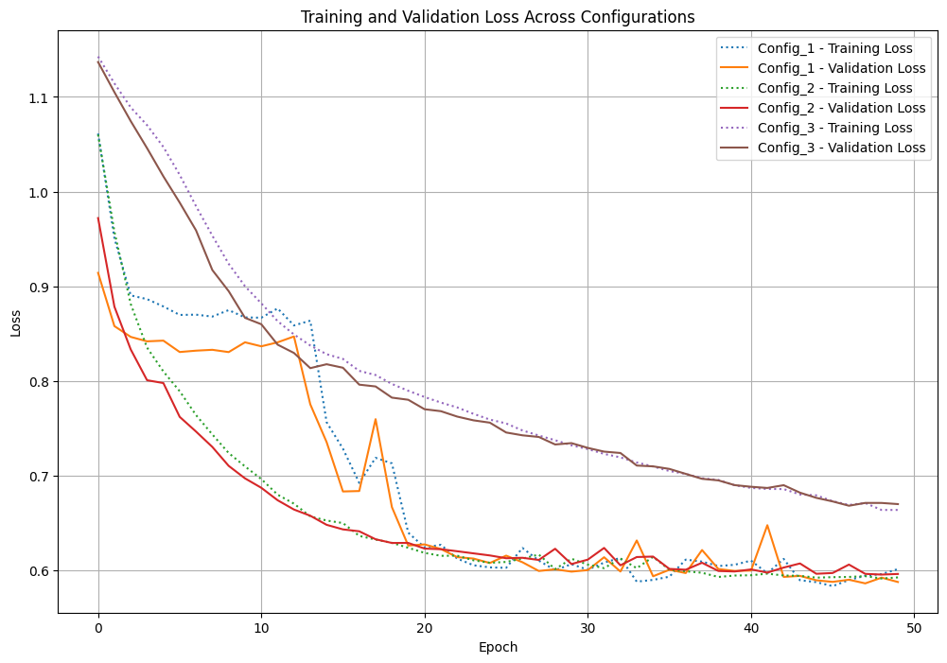

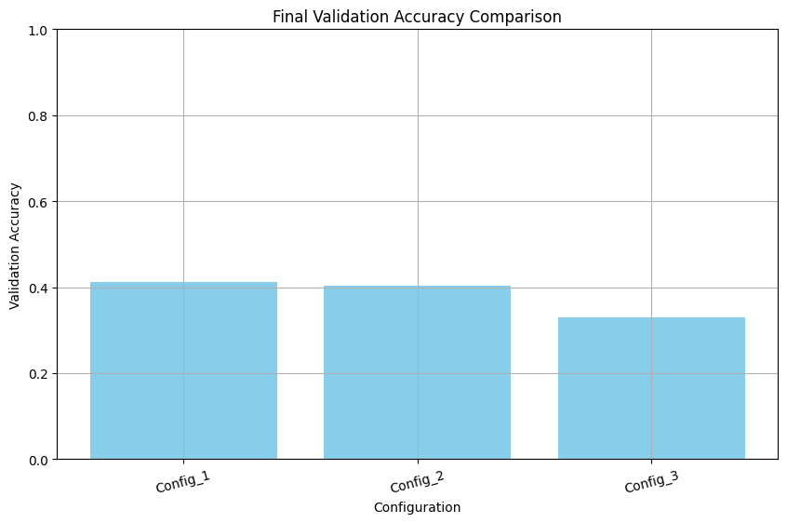
Monitoring ML Training and Validation and Deployment
Framework for logging and displaying Training and Validation

Slide 16
Store or communicate losses during training
Configurations
# Define configurations to compare
configurations = [
{"hidden_dim": 64, "learning_rate": 0.01, "batch_size": 16, "epochs": 50, "name": "Config_1"},
{"hidden_dim": 128, "learning_rate": 0.005, "batch_size": 32, "epochs": 50, "name": "Config_2"},
{"hidden_dim": 32, "learning_rate": 0.001, "batch_size": 8, "epochs": 50, "name": "Config_3"},
]
# Train and log each configuration
for config in configurations:
with mlflow.start_run(run_name=config["name"]):
# Log metrics for this epoch
mlflow.log_metric("train_loss", train_loss, step=epoch)
mlflow.log_metric("val_loss", val_loss, step=epoch)
# Log final metrics and parameters
mlflow.log_param("hidden_dim", config["hidden_dim"])
mlflow.log_param("learning_rate", config["learning_rate"])
mlflow.log_param("batch_size", config["batch_size"])
mlflow.log_param("epochs", config["epochs"])
# Save metrics to JSON for visualization
results = {"train_loss": train_losses, "val_loss": val_losses}
with open(f"{output_dir}/{config['name']}_metrics.json", "w") as f:
json.dump(results, f)
print(f"Metrics saved for {config['name']}.")
Log Parameters
Log Losses

Slide 17
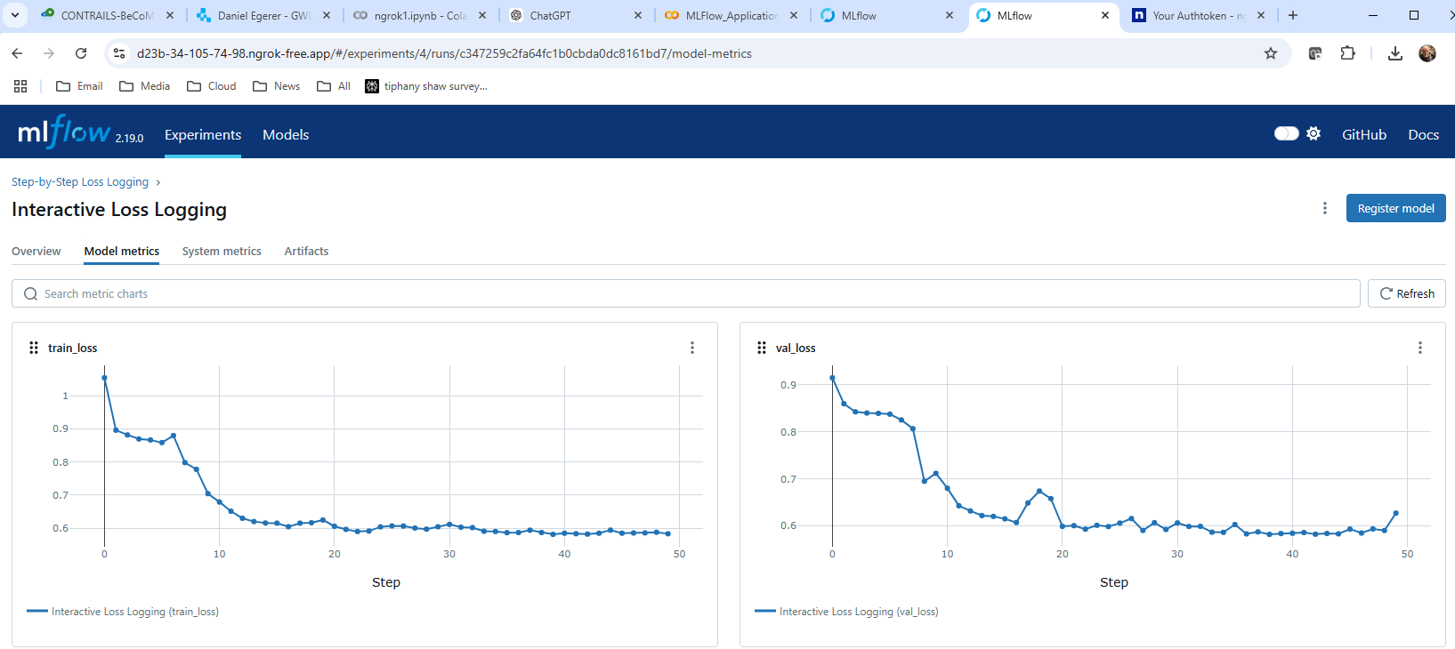
Easy Setup of ML Flow e.g. on Colab using ngrok
Run ML applications somewhere
Run MLFLOW Server on Notebook
Connect to MLFlow through ngrok public url

Slide 18
E-AI Basic Tutorials
Tutorial E-AI Basics 4: January Wednesday 22, 2025, 11-12 CET
"MLOps" - Machine Learning Operations
4.1 Overview (20') [RP]
4.2 MLOps in relation to traditional Weather forecasting (20') [MJ]
4.3 Road to MLOps (20’) [DN]
Tutorial E-AI Basics 5: February Wednesday 19, 2025, 11-12 CET
MLflow - an open-source platform for managing the machine learning lifecycle
5.1 Overview - User perspective (20') [TG]
5.2 Logging to MLflow as a ML software developer (20') [HT]
5.3 Running MLflow server as a user and as a service (20') [MJ]
Tutorial E-AI Basics 6: February Wednesday 26, 2025, 11-12 CET
CI/CD - Continuous Integration and Continuous Deployment of ML codes
6.1 Overview – What can CI/CD do for you? (20') [MJ]
6.2 Basic tests with Pytest (20') [JD]
6.3 Setting up a runner (20') [FP]
4.2
AI generated Images, © Roland Potthast 2024

Slide 19
Weather Forecasting Innovation Process
Feedback
Verification
Deployment New operational system
Verification
Run close to real-time Parallel to operational system
Verification
Tests in routine environment
Verification
Development of Model and Methods
Experiment system Individual model runs and case studies

Slide 20
Weather Forecasting Innovation Process
Feedback
Verification
Deployment New operational system
External adaptation and extensive testing
Verification
depending on the impact on .
Run close to real-time Parallel to operational system
downstream services
Verification
Tests in routine environment
Verification
Development of Model and Methods
Experiment system Individual model runs and case studies

Slide 21
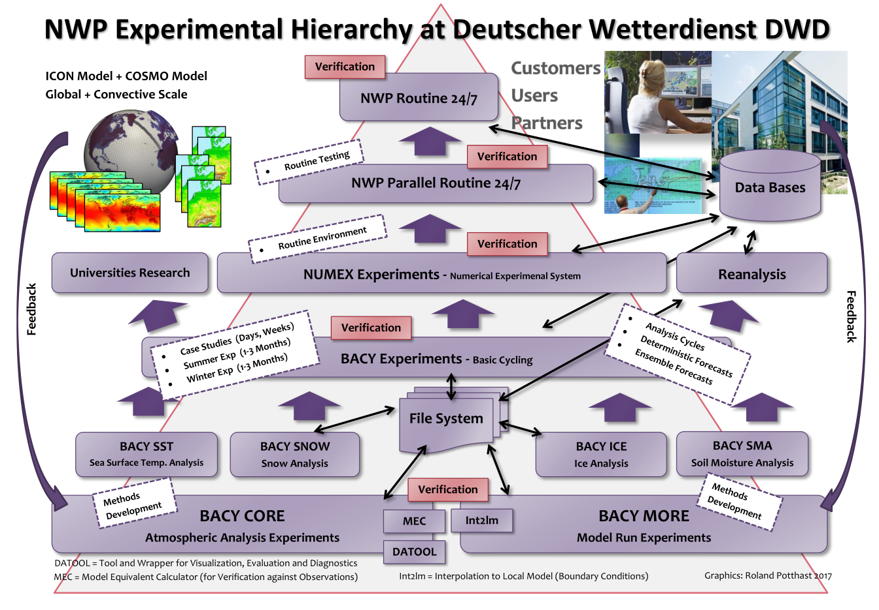
Weather-Forecasting-System Update Cycle
Frequency/Agility of update process depends on
Strategic Goals
Involved Departments
Responsibilities
Degree of Automation
Technical test
Forecast cycling
Score verification
Communication
Dependencies
Identification of
Interfaces
Incremental Updates
Breaking Updates
Versioning system
Code
Changelog
User Communication

Slide 22
From Research to Operations in traditional NWP – Building Blocks I
1. Version Control and Source Code Management
Use Case: Manages code changes and enables team collaboration (e.g., Git).
Considerations: Branching strategies (e.g., GitFlow), conflict resolution, versioning infrastructure code.
2. CI/CD (Continuous Integration/Continuous Deployment)
Use Case: Automates the build, test, and deployment processes.
Considerations: Test coverage, automation tools (e.g., Jenkins, GitHub Actions), deployment strategies (e.g., Blue-Green Deployments).
3. Infrastructure as Code (IaC)
Use Case: Defines and manages infrastructure programmatically (e.g., Terraform, Ansible).
Considerations: Repeatability, modularity, handling sensitive credentials securely.
4. Monitoring and Logging
Use Case: Monitors systems and applications (e.g., Prometheus, Grafana, ELK Stack).
Considerations: Define KPIs, avoid logging sensitive data, and set up alerts for critical issues.
5. Automation
Use Case: Reduces manual tasks (e.g., testing, deployments, updates).
Considerations:
NWP Code is controlled in one or the other way (git, SVN, VCS, enumerated directories...)
Classically software is pre-installed on the HPC
Some flexibility with module system
Slowly changing requirements
System monitoring by system department or vendor
Depends on the NWP Model or Component.
Automation build into version control system
Automated via additional tools like Jenkins
Execution of NWP model, i.e. forecast and related tasks are usually automated (e.g. ecflow)
Test suite
Centralized set of manual experiments
Decentralized set of manual experiments
Deployment, Updates, ... are usually manual or semi-manual

Slide 23
From Research to Operations in traditional NWP – Building Blocks II
6. Collaboration and Communication
Use Case: Improves transparency and teamwork between development and operations.
Considerations: Use tools like Slack or Rocket chat, establish feedback loops, and define clear responsibilities.
7. Security (DevSecOps)
Use Case: Integrates security into development from the start.
Considerations: Automate security checks, manage vulnerabilities, and enforce access controls.
8. Containerization and Orchestration
Use Case: Standardizes applications and deployment processes (e.g., Docker, Kubernetes).
Considerations: Resource allocation, scalability, and managing network communication.
9. Feedback and Continuous Improvement
Use Case: Drives improvement through feedback loops and analytics.
Considerations: Gather data, hold retrospectives, and define metrics to measure success.
10. Scalability, Reliability and Portability
Use Case: Ensures systems are flexible and robust.
Considerations: Redundancy, load testing, and implementing auto-scaling strategies.
Continuous feedback by forecasters and research community
Code is self-developed or from trustworthy partners
NWP code has fewer dependencies than a modern Python environment
Access control through POSIX filesystem and/or separate operational systems
NWP system often tightly bound to HPC setup
Not extensively used in HPC NWP
Challenge: MPI in container would depend on the hardware/vendor

Slide 24
Key novelties in AI/ML – Model Reproducibility
ML model consists of model structure (code) and weights
Whole models can be serialised into a single binary file
Generic runtime becomes inference application
Key factors for Model-Versioning and Reproducibility
Data Lineage
Which data was used in the training?
Which data at which stage?
Pre-processing?
Implementation
Good documentation is key for continuous improvement
Many aspects can be tracked with tools like MLflow
Model Registry
Weights
Training Settings
Trained from scratch or using pre-trained model?
Randomness
Does learning process involve randomness?
Can a seed be used to control it?

Slide 25
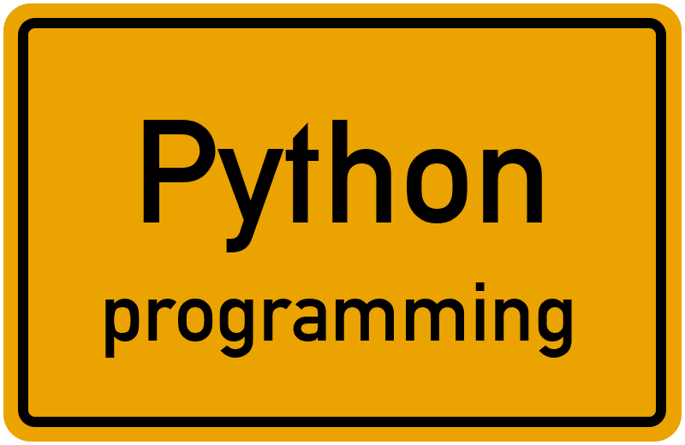

Key novelties in AI/ML – Software Environment
ML models build on the shoulders of giants
Extended use of external software packages
More complex environment
Unprecedented pace of development
It's possible to build valuable services quickly
Need for flexible code execution
Huge resource-imbalance between training and inference
Training on external infrastructure
Common solution: Containers “Infrastructure as Code”

Slide 26
Infrastructure as Code – Numerical Model
FROM ubuntu
# install compiler and requirements
RUN apt-get update \
&& apt-get install -y \
gcc g++ gfortran \
libc-dev libnetcdff-dev \
&& rm -rf /var/lib/apt/lists/*
RUN git clone "$MODEL_REPO" /tmp/model
# get other prerequisites
COPY scripts/* /tmp/scripts/
RUN cd /tmp/model \
&& /tmp/scripts/build_model.sh
Base Image
OS & Libraries
Compiler + model requirements
Model Repository
+ install
+ get source code
Model Source
+ compile with
Compile Scripts
generates
Container Image
Compiled
Model
Simplified Dockerfile

Slide 27
Infrastructure as Code – ML Model
FROM python:3.11-slim
# compile eccodes
COPY dockerfiles/provision.eccodes.sh .
RUN bash ./provision. eccodes.sh
RUN useradd -ms /bin/bash user
USER user
WORKDIR /home/user
ENV VIRTUAL_ENV=/home/user/venv
ENV PATH="$VIRTUAL_ENV/bin:$PATH"
# create a new virtual environment
RUN cd /home/user \
&& python3 -m venv --system-site-packages $VIRTUAL_ENV
# install pytorch for CUDA (Nvidia)
RUN pip install --upgrade pip \
&& pip install --no-cache-dir \
torch==2.1.1+cu118 \
torchvision==0.16.1+cu118 \
--extra-index-url \
https://download.pytorch.org/whl/cu118
RUN git clone "$ML_REPO" /home/user/ml_model \
&& pip install -r /home/user/ml_model/requirements.txt
Pyhon Image
OS & Python
+ compile eccodes (or get it via pip)
Create user
+ create virtual python environment
ML Model Repository
+ install pytorch
+ clone and install ML Code
Model Source
generates
Container Image
Python environment + own ML model
Model Registry
Can use
Simplified Dockerfile
Weights

Slide 28
provision.eccodes.sh
set -e
apt-get update && apt-get install -y \
wget \
python3 \
gcc g++ gfortran \
libc-dev \
python3-dev python3-venv \
git \
cmake \
make \
libaec-dev \
perl \
&& rm -rf /var/lib/apt/lists/*
wget -q https://confluence.ecmwf.int/download/attachments/45757960/eccodes-2.33.0-Source.tar.gz
tar xzf eccodes-2.33.0-Source.tar.gz
rm eccodes-2.33.0-Source.tar.gz
cd eccodes-2.33.0-Source && mkdir build
cd build && cmake .. -DCMAKE_INSTALL_MESSAGE=NEVER
make -j$(grep processor /proc/cpuinfo | wc -l)
make install VERBOSE=0
cd ../../ && rm -rf eccodes-2.33.0-Source
# clean up packages that were used only for this build process
apt-get remove -y \
gcc g++ gfortran \
libc-dev
apt autoremove -y
rm -rf /var/lib/apt/lists/*

Slide 29
Infrastructure Comparison
Numerical Model: Compiled Binary + O(10) libraries (shared objects)
ML Model: Python environment with O(10 000) modules
FROM ubuntu
# install compiler and requirements
RUN apt-get update \
&& apt-get install -y \
gcc g++ gfortran \
libc-dev libnetcdff-dev \
&& rm -rf /var/lib/apt/lists/*
RUN git clone "$MODEL_REPO" /tmp/model
# get other prerequisites
COPY scripts/* /tmp/scripts/
RUN cd /tmp/model \
&& /tmp/scripts/build_model.sh
FROM python:3.11-slim
# compile eccodes
COPY dockerfiles/provision.eccodes.sh .
RUN bash ./provision. eccodes.sh
RUN useradd -ms /bin/bash user
USER user
WORKDIR /home/user
ENV VIRTUAL_ENV=/home/user/venv
ENV PATH="$VIRTUAL_ENV/bin:$PATH"
# create a new virtual environment
RUN cd /home/user \
&& python3 -m venv --system-site-packages $VIRTUAL_ENV
# install pytorch for CUDA (Nvidia)
RUN pip install --upgrade pip \
&& pip install --no-cache-dir \
torch==2.1.1+cu118 \
torchvision==0.16.1+cu118 \
--extra-index-url \
https://download.pytorch.org/whl/cu118
RUN git clone "$ML_REPO" /home/user/ml_model \
&& pip install -r /home/user/ml_model/requirements.txt
Simplified Dockerfiles

Slide 30
Infrastructure Comparison
FROM python:3.11-slim
# compile eccodes
COPY dockerfiles/provision.eccodes.sh .
RUN bash ./provision. eccodes.sh
RUN useradd -ms /bin/bash user
USER user
WORKDIR /home/user
ENV VIRTUAL_ENV=/home/user/venv
ENV PATH="$VIRTUAL_ENV/bin:$PATH"
# create a new virtual environment
RUN cd /home/user \
&& python3 -m venv --system-site-packages $VIRTUAL_ENV
# install pytorch for CUDA (Nvidia)
RUN pip install --upgrade pip \
&& pip install --no-cache-dir \
torch==2.1.1+cu118 \
torchvision==0.16.1+cu118 \
--extra-index-url \
https://download.pytorch.org/whl/cu118
RUN git clone "$ML_REPO" /home/user/ml_model \
&& pip install -r /home/user/ml_model/requirements.txt
Numerical Model: Compiled Binary + O(10) libraries
ML Model: Python environment with O(10 000) modules
SYTEM
Note on Containerization:
Operators and developers can separate concerns in different container layers
General Pytorch
Environment
Application
Simplified Dockerfiles

Slide 31
ML Ops Implications
Many ML Ops aspects are already in place
New aspects:
Documentation of training pipeline
Data Lineage tracking
Settings and Seeds management
(Version control of source code)
Implementation of containerization for portable and reproducible services
Automation in deployment process
Novel tools and techniques require collaboration and teamwork from many individuals across research and development to operations
ML models benefit from leveraging tools from a broader community

Slide 32
E-AI Basic Tutorials
Tutorial E-AI Basics 4: January Wednesday 22, 2025, 11-12 CET
"MLOps" - Machine Learning Operations
4.1 Overview (20') [RP]
4.2 MLOps in relation to traditional Weather forecasting (20') [MJ]
4.3 Road to MLOps (20’) [DN]
Tutorial E-AI Basics 5: February Wednesday 19, 2025, 11-12 CET
MLflow - an open-source platform for managing the machine learning lifecycle
5.1 Overview - User perspective (20') [TG]
5.2 Logging to MLflow as a ML software developer (20') [HT]
5.3 Running MLflow server as a user and as a service (20') [MJ]
Tutorial E-AI Basics 6: February Wednesday 26, 2025, 11-12 CET
CI/CD - Continuous Integration and Continuous Deployment of ML codes
6.1 Overview – What can CI/CD do for you? (20') [MJ]
6.2 Basic tests with Pytest (20') [JD]
6.3 Setting up a runner (20') [FP]
4.3
AI generated Images, © Roland Potthast 2024

Slide 33
The Winding Road to MLOps Tutorial E-AI Basics: MLOps – Machine Learning Operations
Daniele Nerini
Néstor Tarin Burriel
Gabriela Aznar Siguan
Pascal Tay

Slide 34
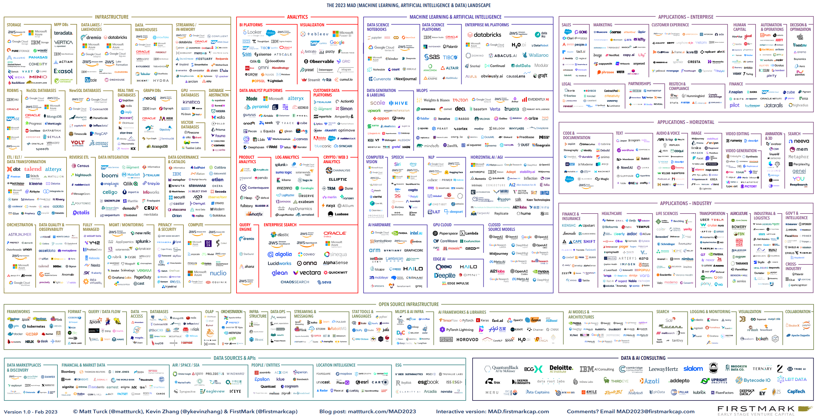
https://mad.firstmark.com/

Slide 35
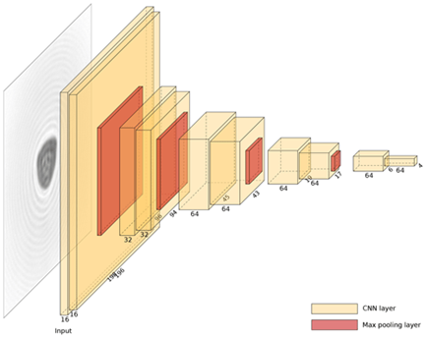
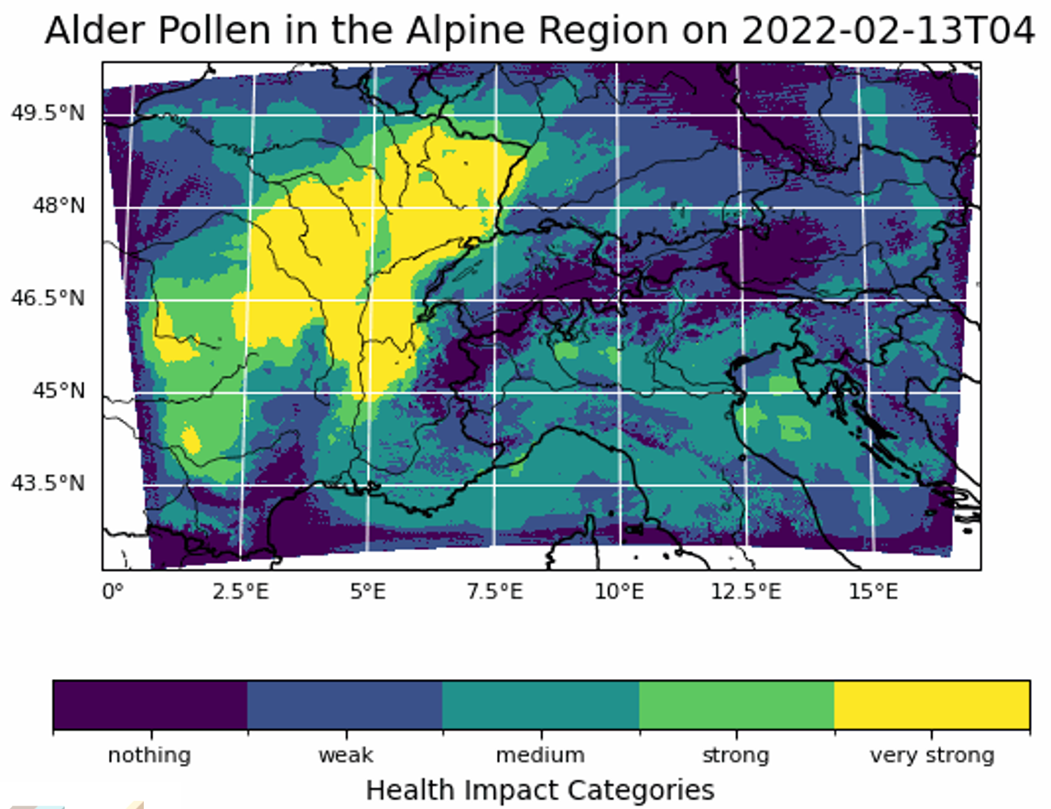
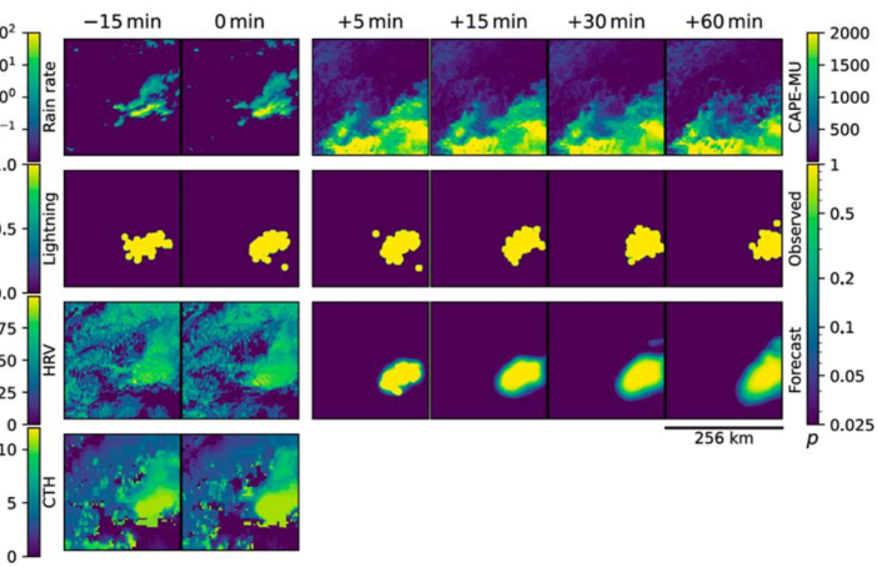
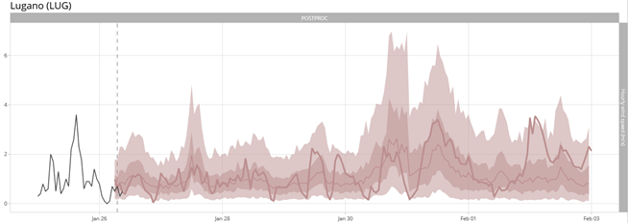






Vision for Machine Learning Infrastructure
ML applications owned by domain experts
ML Applications
ML applications are owned by ML scientists at MeteoSwiss.
ML libraries based on OSS and their communities.
Integration into production is enforced with blueprints, and well-documented APIs and SDKs, managed by MLOps team.
Base infrastructure is managed by IT or outsourced to public cloud.
measurements
MLWP
nowcasting
postprocessing
OSS libraries/ community support
ML Ecosystem
ML tooling
managed by MLOps team
ML Integration
Project templates
Experiment tracking
Model
registry
Orchestrator
ML Compute
ML Platform
Managed infrastracture
(HPC, public cloud)
Workload manager
CPU worker pool
Container runtime
Orchestration
S3
GPU worker pool
Network
AIM

Slide 36

The journey so far …
2022
PoC1: Kubeflow Hackathon
2023
PoC2: On-prem ML pipelines
2024
Design ML Platform architecture
Plan implementation
2025
Go Live!
The road to the St.Gotthard Pass
StudioJS, CC BY-SA 4.0, via Wikimedia Commons

Slide 37

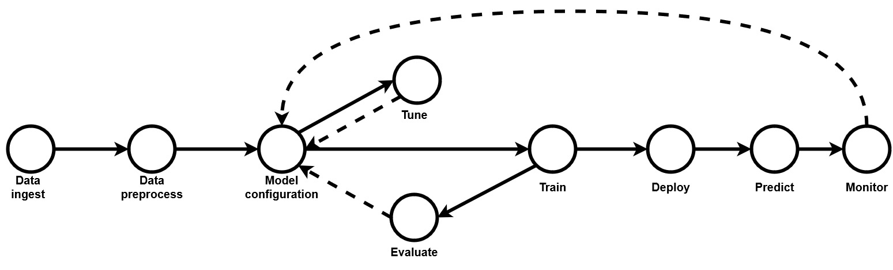
PoC1: Kubeflow Hackathon
Goal: Build an end-to-end ML pipeline on top of Kubernetes.
Use case: Predict horizontal visibility at Zurich Airport (postprocessing)
Data: 1 year of NWP hourly features (forecasts of surface temperature and humidity) and labels (measured visual range in km).

Slide 38
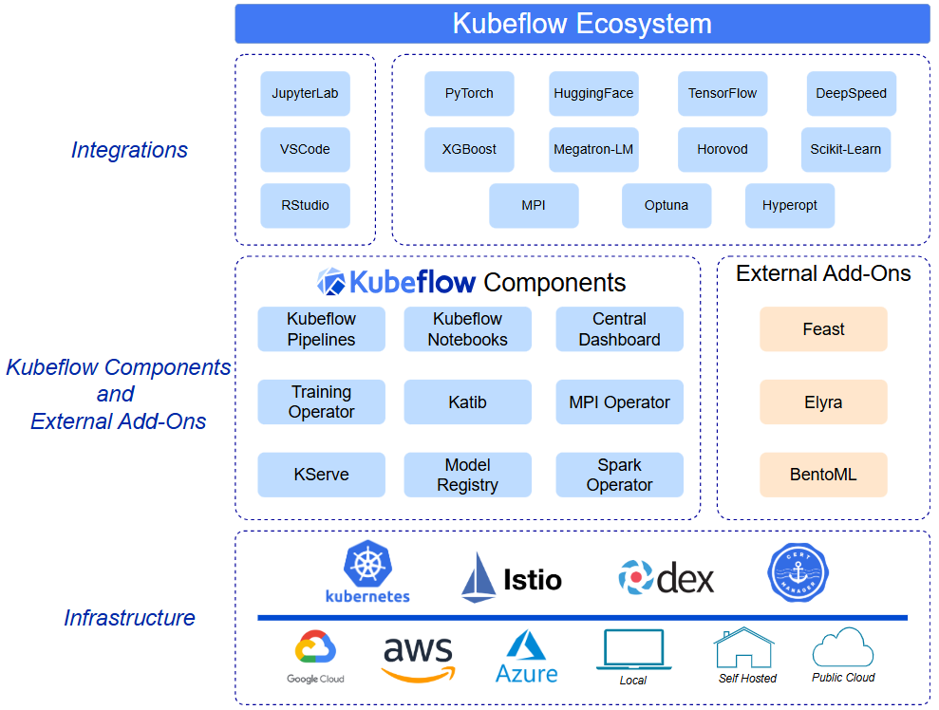
Kubeflow
An ecosystem of open-source projects to address each stage in the ML lifecycle.
Support for best-in-class open source tools and frameworks.
Sits on top of Kubernetes.
www.kubeflow.org

Slide 39
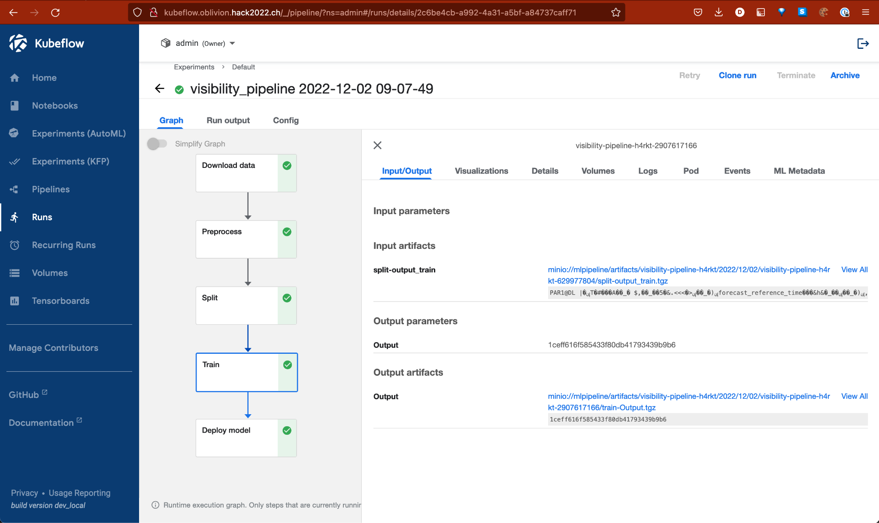
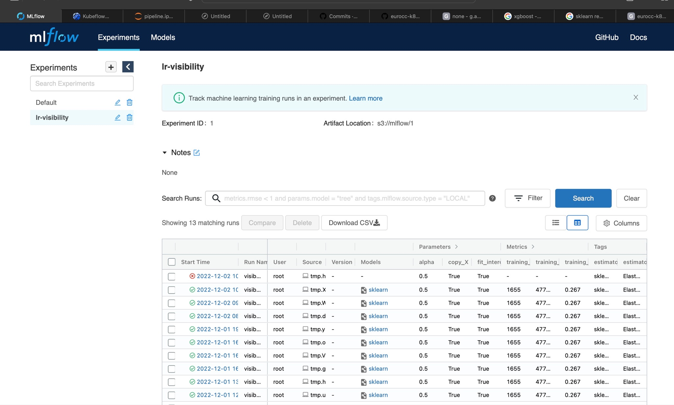
Results: ML pipeline
Kubeflow UI
MLflow UI

Slide 40
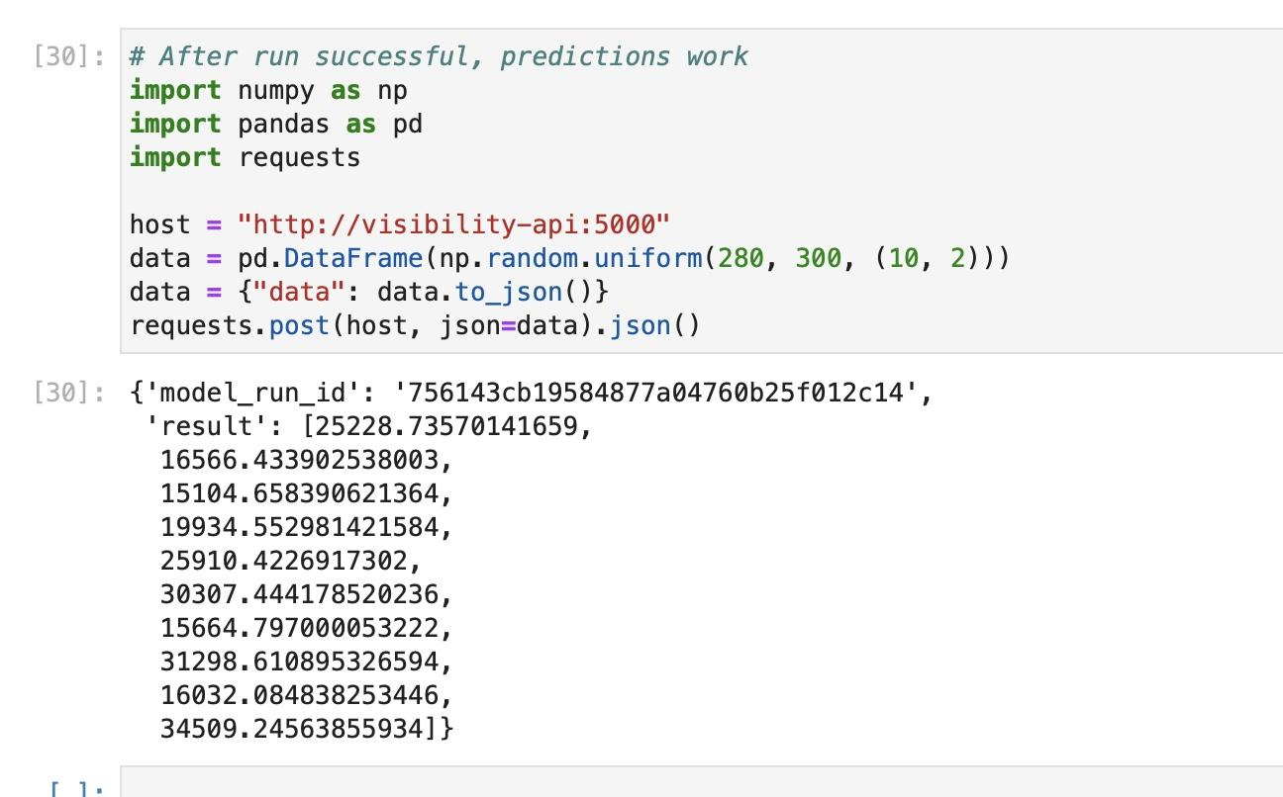
Results: Inference
The trained model is used to make predictions on new data.
Online/synchronous predictions are generated and returned as soon as requested via a REST API.

Slide 41
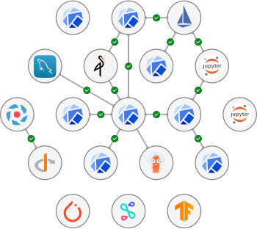
Conclusions for PoC1
We managed to build an end-to-end ML pipeline using our internal data infrastructure.
We only tasted the power of Kubeflow as an MLOps framework, still a lot to explore and learn!
However, Kubeflow is a complex ecosystem of services, which seems somewhat challenging to maintain.
Next: Test simpler setup in a production-ready environment.

Slide 42
PoC2: On-prem ML pipeline
Goal: Build an end-to-end ML pipeline using the set of components that are already available in our production environment:
GitLab for code versioning
Jenkins for CI/CD
Airflow for orchestration
Use HPC resources for training (access to GPUs)
Use Openshift for inference (Openshift)
Use case: Postprocessing of wind

Slide 43
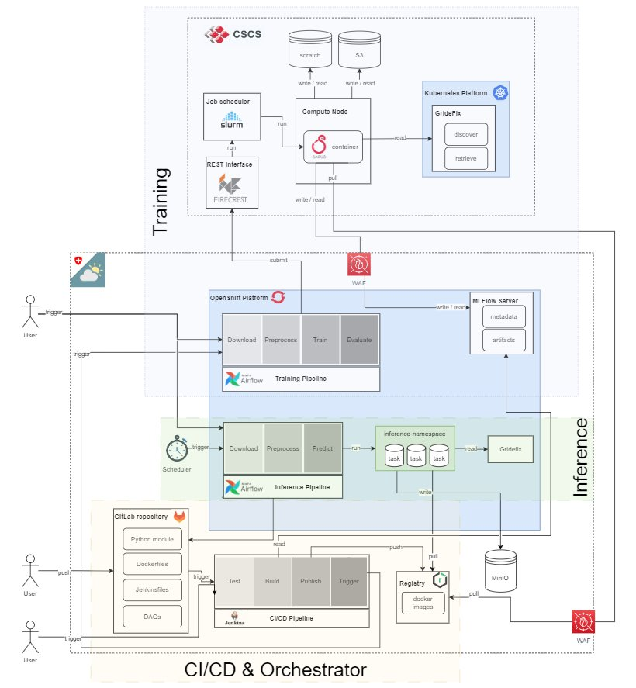
Setup

Slide 44
Demo PoC2

Slide 45
Conclusions for PoC2
Training at CSCS (HPC).​
Inference on prem (Openshift).​
On-prem job orchestration (Airflow).​
On-prem CICD (Jenkins).
Track ML experiments and metadata (MLflow).​
Use model registry to bridge training and inference pipelines (MLflow).
​
Next: Consolidate PoCs into target architecture.

Slide 46
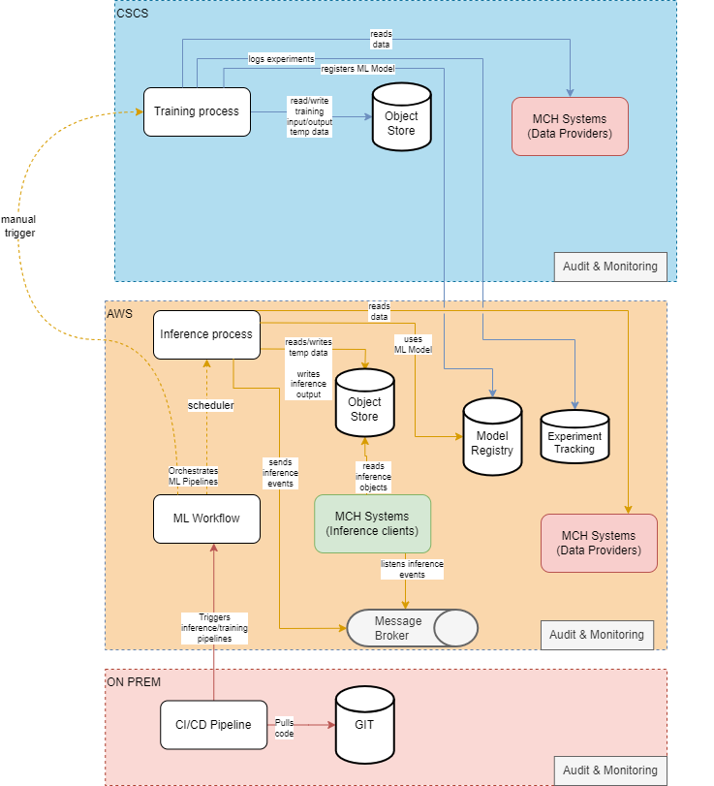
ML Platform: Target architecture
“Multi-Cloud” architecture
HPC (CSCS) provides compute and storage infrastructure for heavy workload:
Training data
Training process
Production-critical components are hosted on Public Cloud (AWS):
Orchestration
Model registry
Inference process
Code version control and CI/CD remain on prem.

Slide 47
Implementation plan
MeteoSwiss is now evaluating the integration of cloud environments, the ML Platform can profit from this journey.
In collaboration with other partners and providers, MeteoSwiss will evaluate the best approach for a multi-cloud ML Platform setup.
The ML Platform will grow together with different use cases, allowing it to have specific targets for the short-term mission, without forgetting the long-term vision.
MLOps best practices and standards will be enforced with templates, base services (e.g. MLflow), and quality gates during operationalization.

Slide 49
Further Information on E-AI
Slides available at GitHub https://github.com/eumetnet-e-ai/tutorials
Recording will be available at EUMETNET SharePoint https://tlnt19059.sharepoint.com/:f:/r/sites/E-AI/Shared%20Documents/Tutorials
Register for E-AI updates and SharePoint Access: marek.jacob@eumetnet.eu
Contacts:
Roland Potthast: Roland.Potthast@dwd.de
Marek Jacob: Marek.Jacob@dwd.de
Daniele Nerini: Daniele.Nerini@meteoswiss.ch
E-AI Working Group „WG3 Operations“ for exchange on MLOps https://chat.europeanweather.cloud

Slide 50
E-AI Basic Tutorials
Tutorial E-AI Basics 4: January Wednesday 22, 2025, 11-12 CET
"MLOps" - Machine Learning Operations
4.1 Overview (20') [RP]
4.2 MLOps in relation to traditional Weather forecasting (20') [MJ]
4.3 Road to MLOps (20’) [DN]
Tutorial E-AI Basics 5: February Wednesday 19, 2025, 11-12 CET
MLflow - an open-source platform for managing the machine learning lifecycle
5.1 Overview - User perspective (20') [TG]
5.2 Logging to MLflow as a ML software developer (20') [HT]
5.3 Running MLflow server as a user and as a service (20') [MJ]
Tutorial E-AI Basics 6: February Wednesday 26, 2025, 11-12 CET
CI/CD - Continuous Integration and Continuous Deployment of ML codes
6.1 Overview – What can CI/CD do for you? (20') [MJ]
6.2 Basic tests with Pytest (20') [JD]
6.3 Setting up a runner (20') [FP]
AI generated Images, © Roland Potthast 2024

